Slide 1
TURKISH COMPETITION AUTHORITY
The Results of TCA’s TV Broadcasting Sector Inquiry in the Era of Digitalization and Convergence
19th September 2017 Veliky Novgorod
RECEP GÜNDÜZ
COMPETITION EXPERT (TCA)
The opinions expressed in this presentation are the speaker's own and do not reflect the view of the Turkish Competition Authority.

Slide 2


OUTLINE
I
THE NEED FOR A SECTOR INQUIRY IN THE TV BORADCAST SECTOR
II
FINDINGS OF THE SECTOR INQUIRY
III
RESULTS AND RECOMMONDATIONS IN THE REPORT
TURKISH COMPETITION AUTHORITY

Slide 3
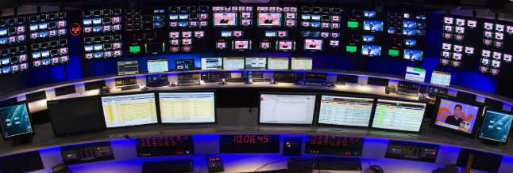
THE NEED FOR A SECTOR INQUIRY
Technological Developments and Convergence: Transformation of the Broadcasting Industry
  Digitalization of the content
  IP Based Networks
  Spread of High Speed Broadband Networks
  The emerge of 3N and 4N Technologies
Newly Emerged Bottlenecks and Competition Issues
The Aim of the Inquiry: To understand fundamentals of the new structure and to act accordingly
TURKISH COMPETITION AUTHORITY

Slide 4

Overview of the New-Generation Broadcasting
Traditional Telecommunication Industry | New-Generation Converged Structure
Sıngle purpose infrastructures (transmission of only voice, only data etc) | Multi-purposed infrastructures (The transmission of data, voice and video all together over a single infrastructure)
PSTN, TV broadcasting and mobile infrastructures | IP – based networks (supply of voice , video and mobile services all together)
Vertically organized sector | Elimination of different segments Blurring of the traditional boundaries between different industry segments (Voice, cable TV, TV Broadcasting, wireless Technologies etc.)
Close relationship between infrastructure and the service | The ability to supply new services and contents independently from infrastructure
infrastructure operator having full control over services supplied to end-users | End-users having more autonomy
TURKISH COMPETITION AUTHORITY

Slide 5

Overview of Broadcasting
Technological Convergence and New Media
«New Media»
  Frequency is no more a bottleneck
  Alteration of customer choice (individualization)
  Widespread pay TV platforms
  Content has come into prominence
  Multi-play bundles
TURKISH COMPETITION AUTHORITY

Slide 6

Broadcasting Industry in Turkey
(Transmission Platforms)
Competition Among Transmission Platforms
  Terrestrial broadcasting transmission- Frequency Shortage (24 national, 17 regional channel)
  Digital Terrestrial Television Broadcasting?
  Satellite TV - Country-wide (More than 500 channels)
  Cable TV- State monopoly (TURKSAT) (In 24 province)
  Broadband Internet
    Entry Barriers for IP TV (Prevalence of fiber infrastructure, Internet speed)
    (Municipal) Right-of-way (ROW) problems
    Fiber infrastructure of electricity and gas companies.
TURKISH COMPETITION AUTHORITY

Slide 7
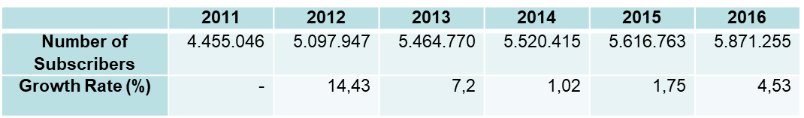
PAY TV PLATFORM BUSINESS IN TURKEY
  Total Pay TV Subscribers:
  % of Subscribers of Pay TV Platforms Based on Infrastructure They Use. :
TURKISH COMPETITION AUTHORITY

Slide 8

PAY TV PLATFORMS AND MULTI-PLAY BUNDLES
Multi-play bundles are more common in the industry
  Double-play bundles (tv-internet) are dominant.
  Competitive Concern: Technical and Economical Replicability of the bundles by competing operators.
  More competitive and efficient telecommunication sector
  Diversity in IPTV, increase in competing firms and competition level.
  Contribution to competition among transmission platforms.
TURKISH COMPETITION AUTHORITY

Slide 9
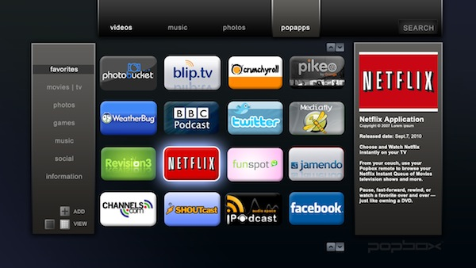
OTT TV/VIDEO SERVICES IN TURKEY
  OTT TV/Video services demonstrate increasing competitive burden on traditional TV services.
  Discussions on network neutrality.
  Obstacles before OTT TV/Video services:
    Development level of broadband internet services,
    Over-the Air broadcasting,
    Access to bootleg stream and copy right infringements
  Currently, OTT TV/Video services are complementary rather than substitute to pay tv services in Turkey.
TURKISH COMPETITION AUTHORITY

Slide 10


ACCESS TO PRIMARY CONTENT IN BROADCASTING
Primary Movie Content
  Display rights of Hollywood Studio’s movies.
  Exclusive Dealing Agreements
  No such major competitive concerns
Primary Sport Content
  Live broadcasting rights for Turkish Football Super League
  The dominant Pay TV Platform owns the right since 2001
  In 2014 TCA granted exemption on the condition that the content should be delivered to other broadcasters via sublicensing
  A need for more competitive bidding structure
TURKISH COMPETITION AUTHORITY

Slide 11
CONCLUSION AND RECOMMENDATIONS
  To increase competition between transmission platforms, to ensure development of alternative infrastructures
  Removal of obstacles in front of transition to terrestrial digital broadcasting,
  Increase penetration of cable TV and internet infrastructure,
  Development of broadband Internet infrastructure, especially fiber infrastructure,
  Improving the network competition including intra-platform competition and making the telecommunication market more efficient and competitive,
  Tender of Turkish Super League live broadcasting rights with more competitive bidding design.
TURKISH COMPETITION AUTHORITY

Slide 12
TURKISH COMPETITION AUTHORITY
THANK YOU
rgunduz@rekabet.gov.tr

